Slide 1
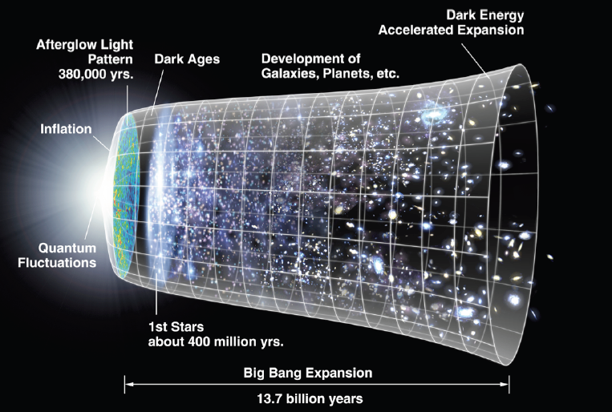
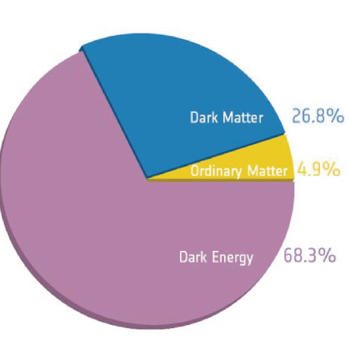
Dark Matter & Dark Energy

Slide 2
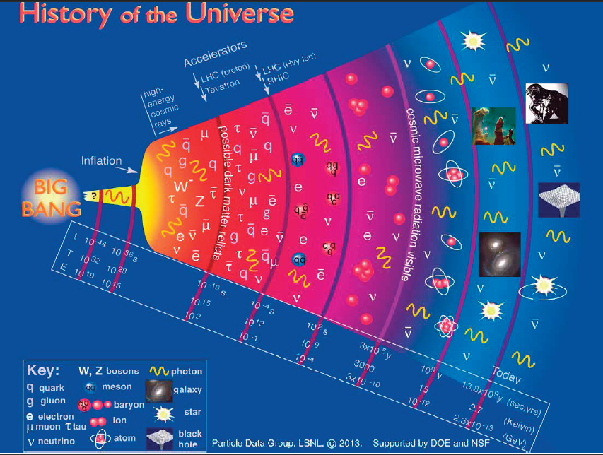
History of the Universe

Slide 3
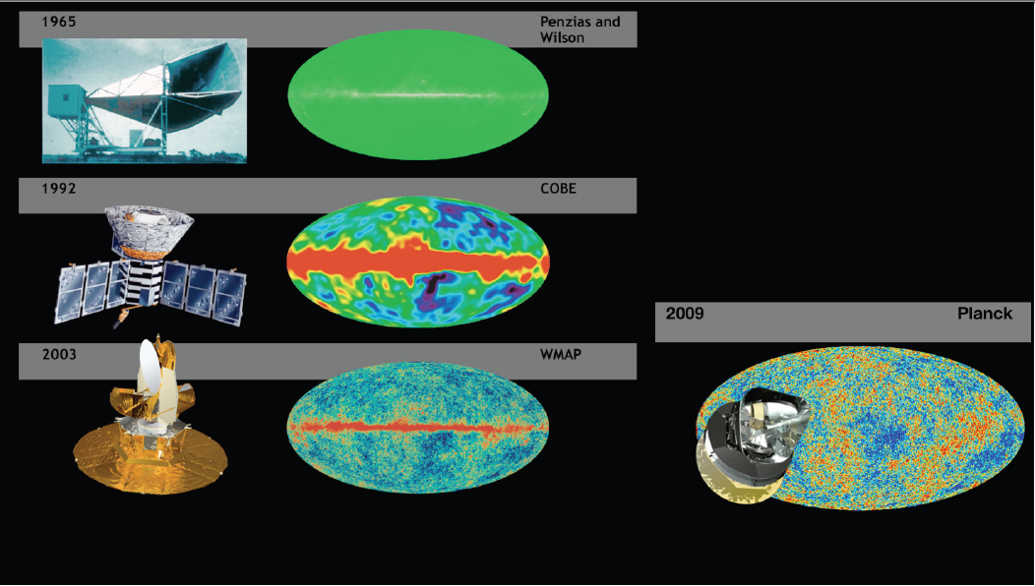
Satellites

Slide 4
Dark Matter (DM)
Dark matter presence is concerned from it’s gravitational pull rather than it’s luminosity
DM makes up 26.8% of the whole universe
DM contributes to the confinement of matter in galaxies (probably also their formation)
DM is not luminous, not absorb or emit light

Slide 5
Dark Matter (DM) (2)
If DM consists of particles, their properties must be following:
They must be electrically neutral, else they would radiate light.
They must interact weakly among themselves and with the normal matter, otherwise their products of reactions would be abundant.
Their density must be compatible with the missing mass balance.
They should have evolved at non-relativistic velocity (slow) at the epoch of matter-radiation equilibrium. We must speak of “cold dark matter”.
Slow (no decay)

Slide 6
Observational Evidence for Dark Matter
Zwicky (1937) was trying to estimate the masses of large clusters of galaxies
He estimated that visible mass of those galaxies 400 times less than the mass needed to explain their rotational motion
He concluded that most of the matter in that clusters is not made up of like luminous objects
His observations were latter confirmed by others and although he had overestimated the amount of DM
It’s now accepted as an established paradigm
https://arxiv.org/ftp/arxiv/papers/1704/1704.06155.pdf

Slide 7
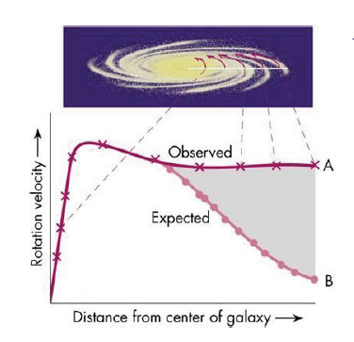
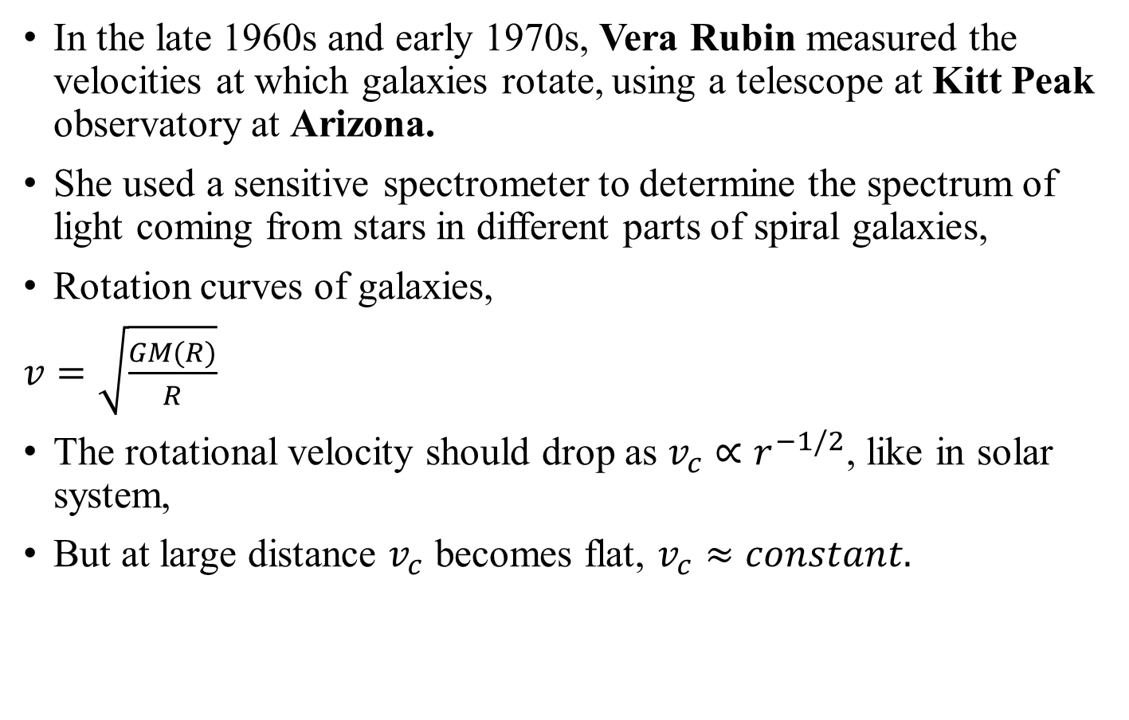
Observational Evidence for Dark Matter (2)
In the late 1960s and early 1970s, Vera Rubin measured the velocities at which galaxies rotate, using a telescope at Kitt Peak observatory at Arizona.
She used a sensitive spectrometer to determine the spectrum of light coming from stars in different parts of spiral galaxies,
Rotation curves of galaxies,
$v=\sqrt{\frac{GM(R)}{R}}$
The rotational velocity should drop as $v_{c}∝r^{−1/2}$, like in solar system,
But at large distance $v_{c}$ becomes flat, $v_{c}≈constant.$

Slide 8
Observational Evidence for Dark Matter (3)
Zwicky was right, because the visible mass of galaxies does not have enough gravity to hold such rapidly moving stars in orbit.
There had to be tremendous amount of unseen matter in the outer region of galaxies where visible stars are relatively few
Rubin and her colleagues kent Ford went on to study some sixty spiral galaxies and always found the same thing.
Indeed, as much as 90% of the mass of galaxy is due to DM.
DM cannot be seen directly from telescopes, because it’s neither absorb not emit light or either EM radiations at any significant level.

Slide 9
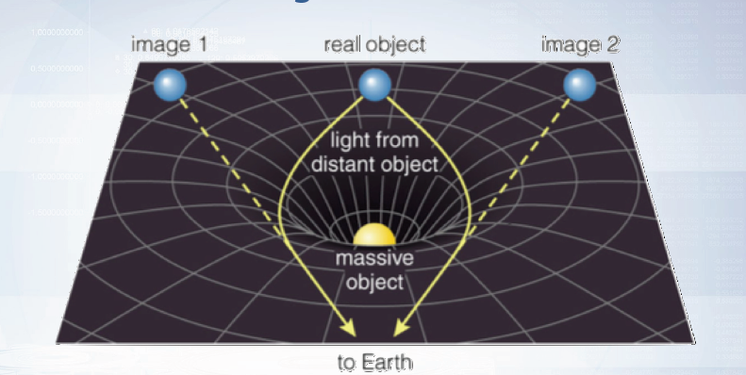
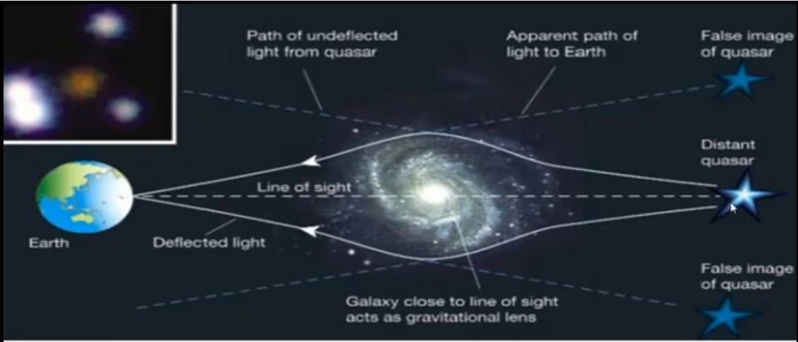
Evidence of DM
Gravitational Lensing (GL): A GL is formed when the light from a very distant, bright source (such as quasar) is bent around a massive object (such as cluster of galaxies) between the source object and the observer.
Studies of many cases of lensing by galaxy clusters show evidence for large amount of dark matter.

Slide 10
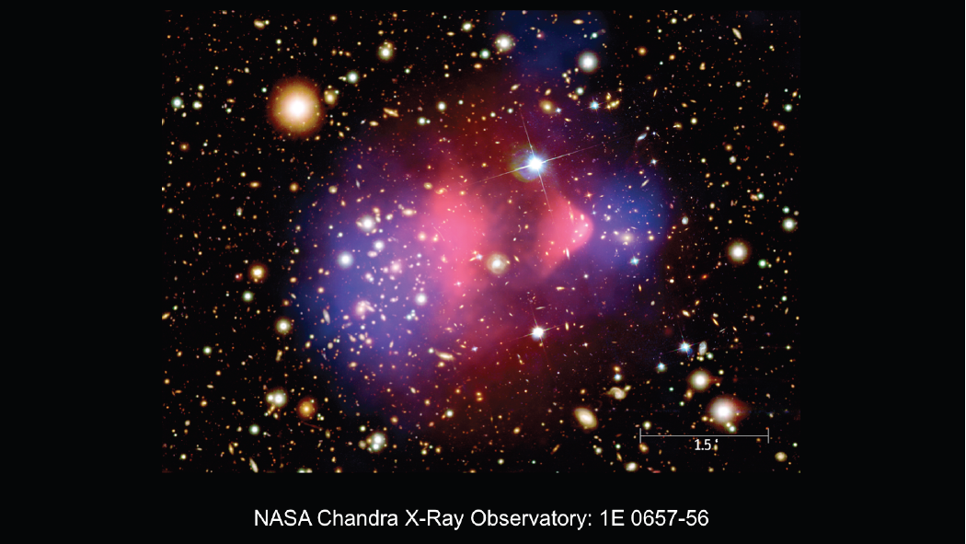
Evidence of DM
Bullet cluster: The most observational evidence to date for DM is bullet cluster, the collision of between two galaxies.
Using gravitational lensing and X-ray imaging, we can visualize the behaviour of the different kind of matter after the collision of cluster of galaxies.
X-ray observations shows that much of the baryonic matter (in the form of gas, or plasma) in the system is concentrated at the center of the system.
Weak gravitational lensing observations of the same system show that much of the mass resides outside the central region of the baryonic gas.
We can conclude from all this evidence that DM accounts for about 85% of the mass of galaxies and their clusters, but this percentage vary a lot. A recently discovered galaxy, named dragonfly 44, is even suspected to contain 99.9% of the DM.

Slide 11
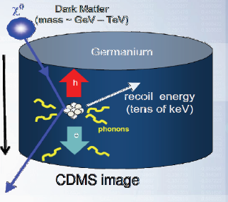
Search Strategies
Direct Strategy: Scattering of DM particle target atomic nuclei. Recoil energy is measured by light, charge or phonons.
Experiments (Several examples):
DAMA/LIBRA, ANAIS,
KIMS, DM-Ice, PICO-LON, SABRE,
Nuclear emulsion (NEWS),
Anysotropic crystals (ADAMO),
Liquid Ar TPC, Negative Ion Time Expansion
Chamber (NITEC), Carbon nanotubes, DRIFT, MIMAC, DMTPC, NEWAGE, D3

Slide 12
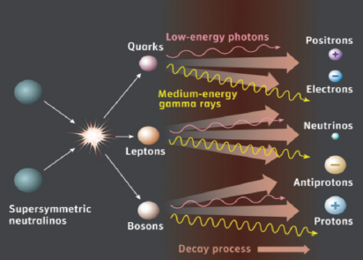
Search Strategies (2)
Indirect strategy: Annihilations (or decays) of DM particles in astrophysical objects generate fluxes of
“standard” detectable particles.
Non trivial to discriminate from the background.
Thus we have to include accelerator searches for Dark
Matter (Hidden Particles).

Slide 13
DM candidates
DM candidates are usually categorized as:
Baryonic: Composed of baryons, i.e. protons and neutrons and combinations thereof.
Non-baryonic:
Hot Dark Matter (HDM): Particles that have zero or near-zero mass, and so move relativistically.
Cold Dark Matter (CDM): Particles sufficiently massive that they move at sub-relativistic velocities
So, DM could be composed of any number of particles, both known and exotic:
MACHOs
WIMPs
Massless neutrinos
Axions
Neutralinos
Photinos

Slide 14
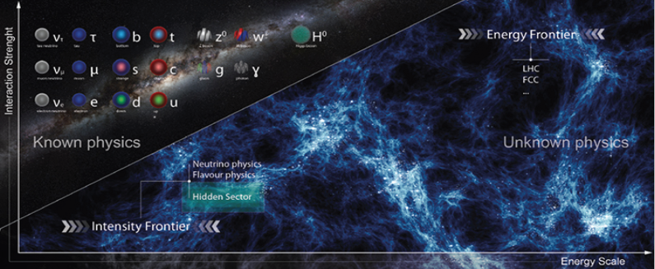
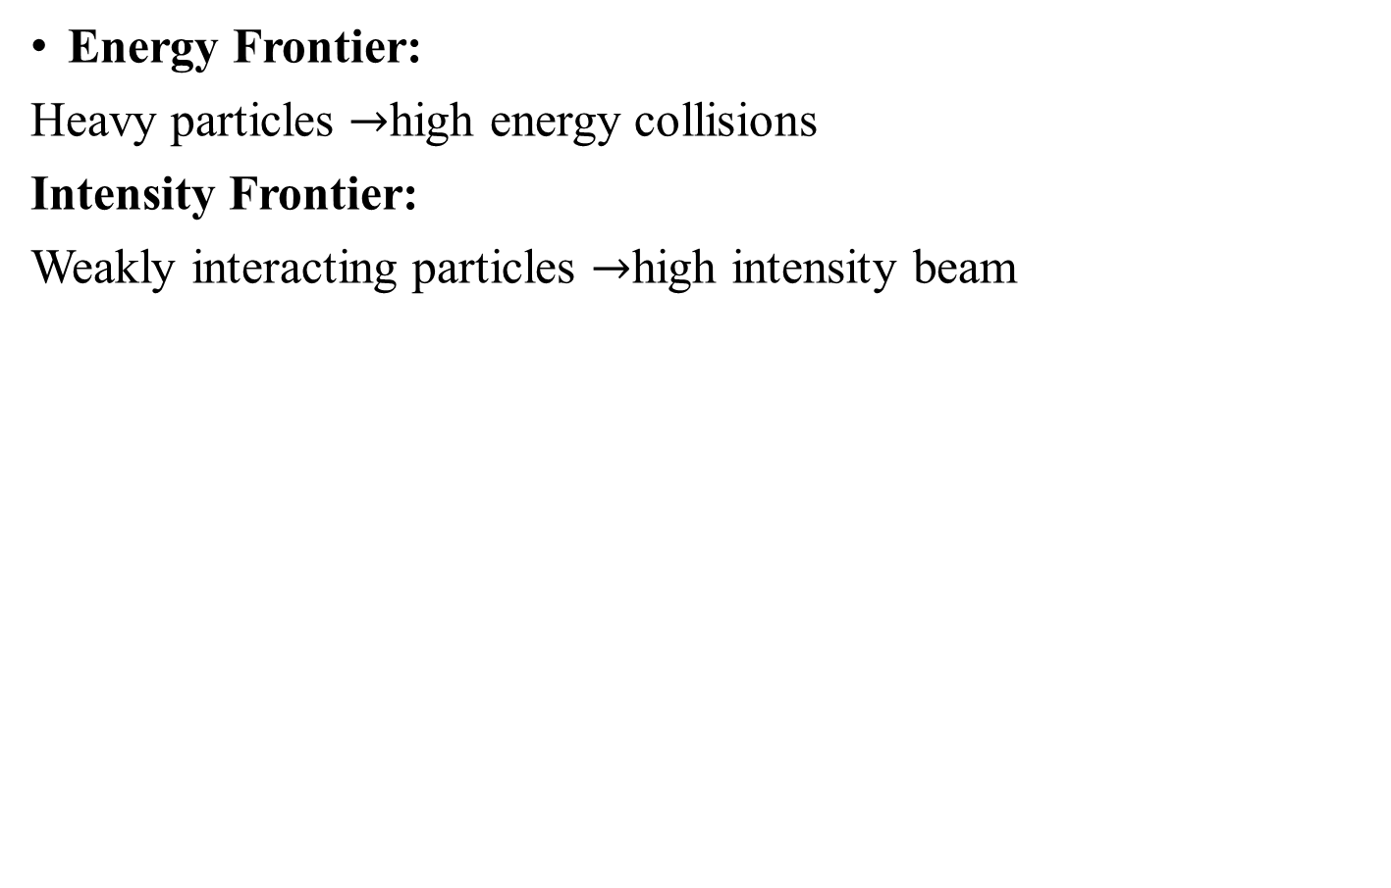
Search for DM at Accelerator Experiment
Energy Frontier:
Heavy particles $→$high energy collisions
Intensity Frontier:
Weakly interacting particles $→$high intensity beam

Slide 15
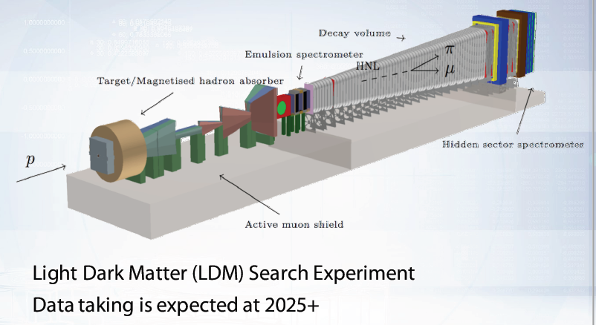
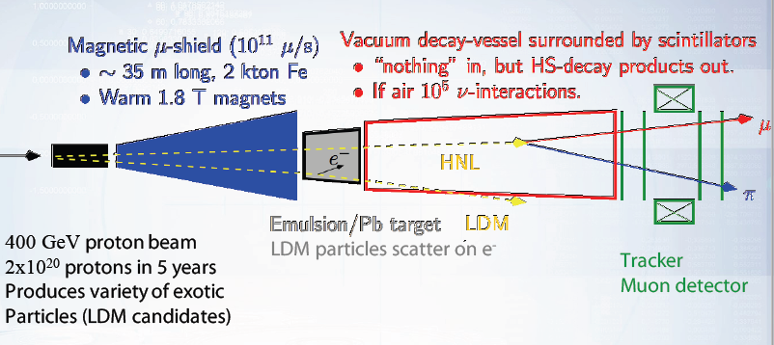
SHiP: Search for Hidden particles

Slide 16
SHiP: Challenges
Physics challenges:
Variety of Hidden Sector portals exploration
Tau neutrino physics
Light Dark Matter (LDM) Search
Engineering challenges
ML challenges:
Experiment design (shield, emulsion optimization, tracker)
Fast simulation
Speed-up data processing
Signal/background separation in emulsion

Slide 17
Dark Energy (DE)
DE is mysterious phenomenon because it causes the expansion of the universe.
By Albert Einstein that DE is not empty space but it is a space which has it’s own energy.
As this energy is a property of space itself so it does not shrink, when it causes the universe to expand more energy or DE is created in the space, which as a result will cause the universe to expand faster and faster.
The key to the discovery of DE lies back in the original observations of Einstein and Hubble.

Slide 18
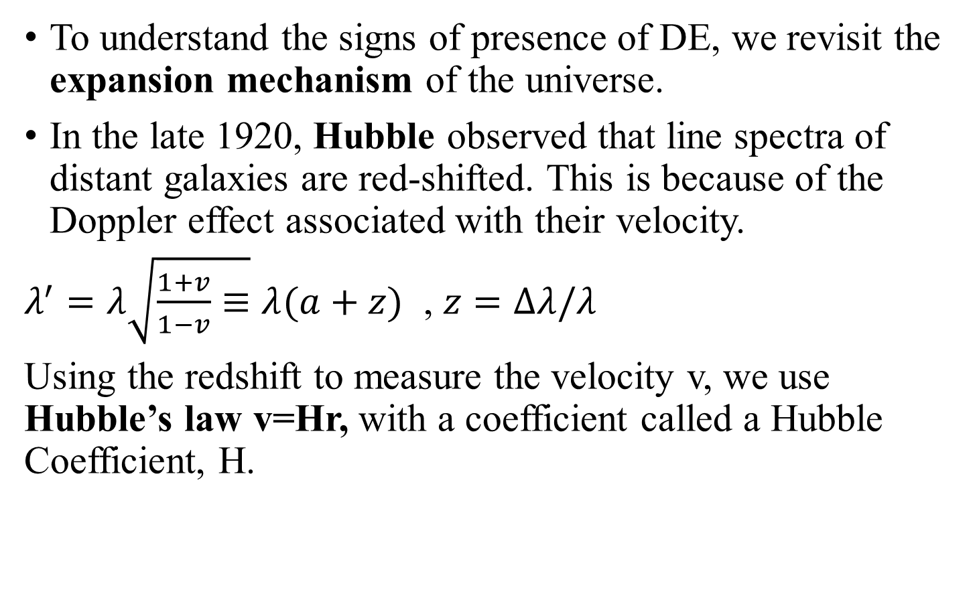
Hubble’s law
To understand the signs of presence of DE, we revisit the expansion mechanism of the universe.
In the late 1920, Hubble observed that line spectra of distant galaxies are red-shifted. This is because of the Doppler effect associated with their velocity.
$λ^{′}=λ\sqrt{\frac{1+v}{1−v}≡}λ(a+z)$ , $z=Δλ/λ$
Using the redshift to measure the velocity v, we use Hubble’s law v=Hr, with a coefficient called a Hubble Coefficient, H.

Slide 19
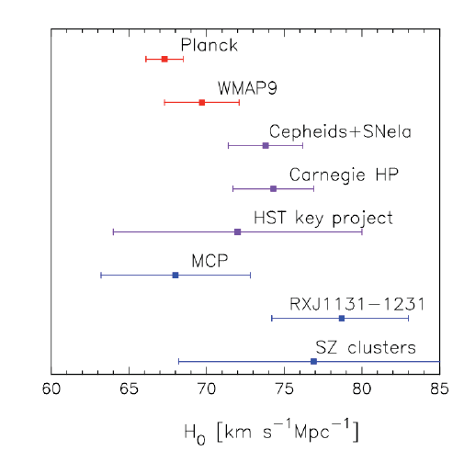
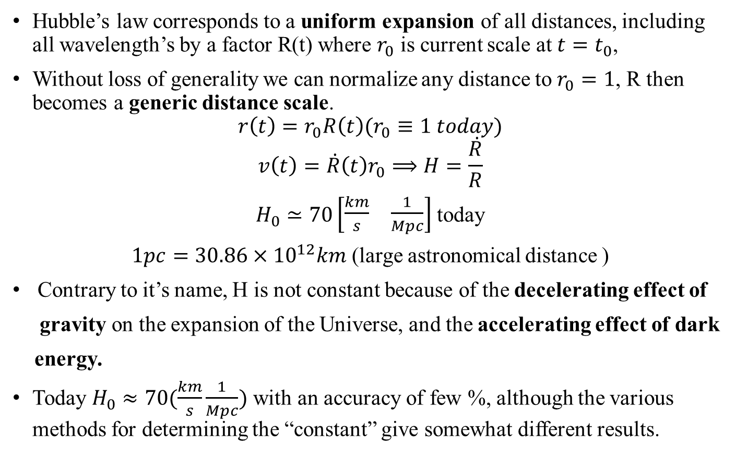
Hubble’s law (2)
Hubble’s law corresponds to a uniform expansion of all distances, including all wavelength’s by a factor R(t) where $r_{0}$ is current scale at $t=t_{0}$,
Without loss of generality we can normalize any distance to $r_{0}=1$, R then becomes a generic distance scale.
$$r\left(t\right)=r_{0}R\left(t\right)(r_{0}≡1 today)$$
$$v\left(t\right)=\dot{R}\left(t\right)r_{0}⟹H=\frac{\dot{R}}{R}$$
$H_{0}≃70\left[\begin{matrix}\frac{km}{s} & \frac{1}{Mpc}\end{matrix}\right]$ today
$1pc=30.86×{10}^{12}km$ (large astronomical distance )
Contrary to it’s name, H is not constant because of the decelerating effect of
gravity on the expansion of the Universe, and the accelerating effect of dark
energy.
Today $H_{0}≈70(\frac{km}{s}\frac{1}{Mpc})$ with an accuracy of few %, although the various methods for determining the “constant” give somewhat different results.

Slide 20
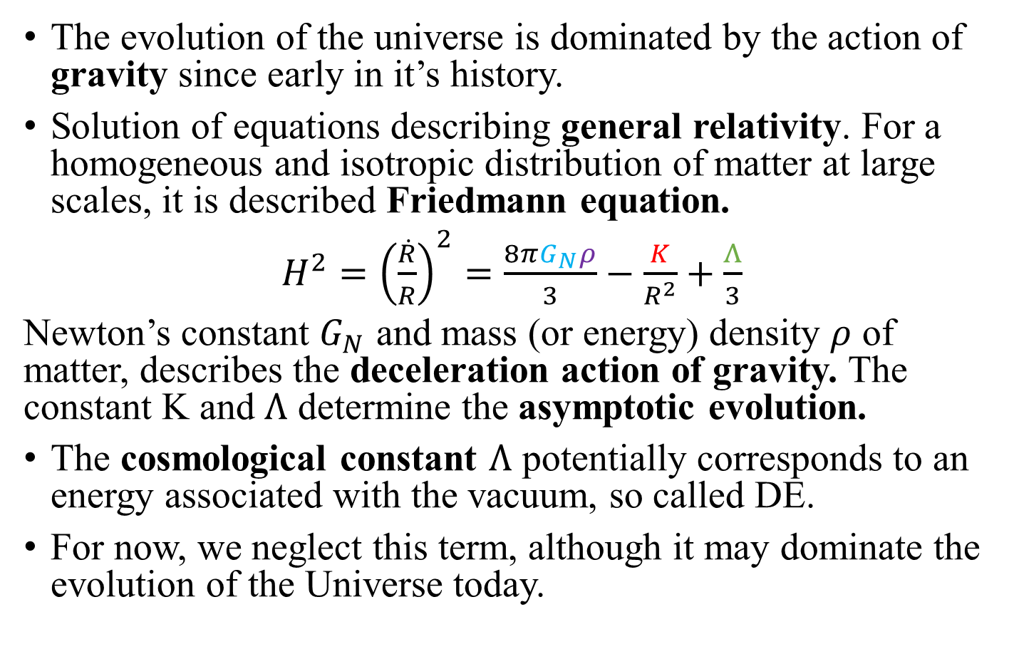
Friedmann equation.
The evolution of the universe is dominated by the action of gravity since early in it’s history.
Solution of equations describing general relativity. For a homogeneous and isotropic distribution of matter at large scales, it is described Friedmann equation.
$H^{2}={\left(\frac{\dot{R}}{R}\right)}^{2}=\frac{8πG_{N}ρ}{3}−\frac{K}{R^{2}}+\frac{Λ}{3}$
Newton’s constant $G_{N}$ and mass (or energy) density $ρ$ of matter, describes the deceleration action of gravity. The constant K and $Λ$ determine the asymptotic evolution.
The cosmological constant $Λ$ potentially corresponds to an energy associated with the vacuum, so called DE.
For now, we neglect this term, although it may dominate the evolution of the Universe today.

Slide 21
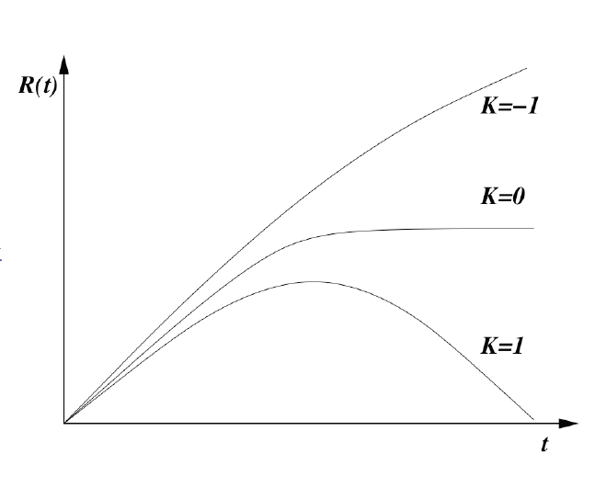
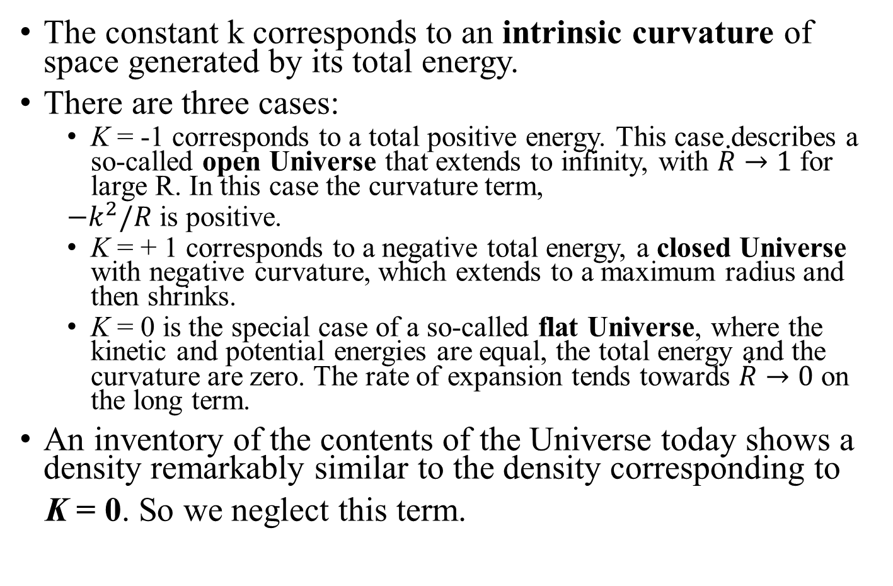
Friedmann equation (2)
The constant k corresponds to an intrinsic curvature of space generated by its total energy.
There are three cases:
K = -1 corresponds to a total positive energy. This case describes a so-called open Universe that extends to infinity, with $\dot{R}→1$ for large R. In this case the curvature term,
$−k^{2}/R$ is positive.
K = + 1 corresponds to a negative total energy, a closed Universe with negative curvature, which extends to a maximum radius and then shrinks.
K = 0 is the special case of a so-called flat Universe, where the kinetic and potential energies are equal, the total energy and the curvature are zero. The rate of expansion tends towards $\dot{R}→0$ on the long term.
An inventory of the contents of the Universe today shows a density remarkably similar to the density corresponding to
K = 0. So we neglect this term.
Open Universe
Falt Universe
Closed Universe

Slide 22
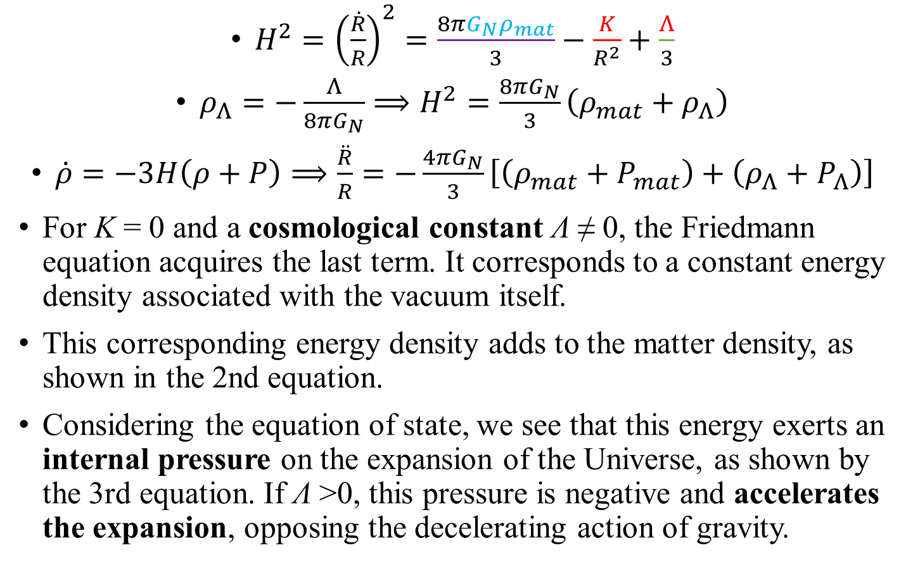
Friedmann equation (3)
$H^{2}={\left(\frac{\dot{R}}{R}\right)}^{2}=\frac{8πG_{N}ρ_{mat}}{3}−\frac{K}{R^{2}}+\frac{Λ}{3}$
$ρ_{Λ}=−\frac{Λ}{8πG_{N}}⟹H^{2}=\frac{8πG_{N}}{3}\left(ρ_{mat}+ρ_{Λ}\right)$
$\dot{ρ}=−3H\left(ρ+P\right)⟹\frac{\ddot{R}}{R}=−\frac{4πG_{N}}{3}\left[\left(ρ_{mat}+P_{mat}\right)+\left(ρ_{Λ}+P_{Λ}\right)\right]$
For K = 0 and a cosmological constant Λ ≠ 0, the Friedmann equation acquires the last term. It corresponds to a constant energy density associated with the vacuum itself.
This corresponding energy density adds to the matter density, as shown in the 2nd equation.
Considering the equation of state, we see that this energy exerts an internal pressure on the expansion of the Universe, as shown by the 3rd equation. If Λ >0, this pressure is negative and accelerates the expansion, opposing the decelerating action of gravity.

Slide 23
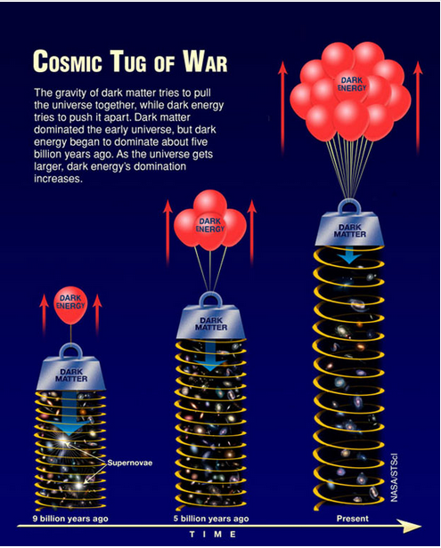

Slide 24
